Slide 1
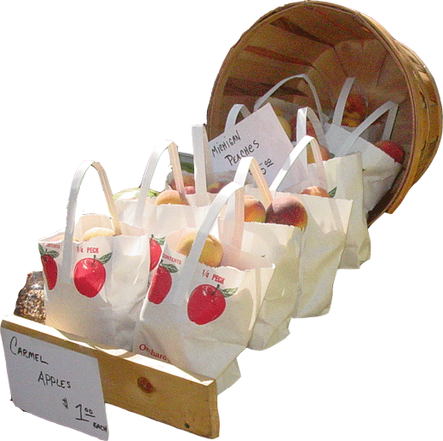
Charlotte’s Website
New Fall Products

Slide 2
From the Garden

Slide 3
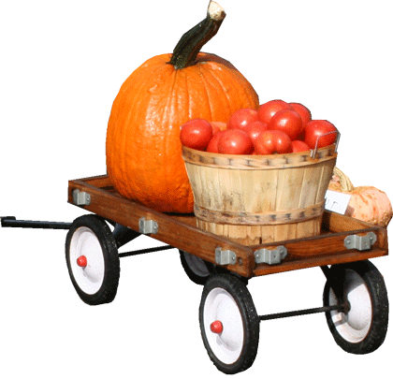
From the Farm to Your Table, That’s Fresh!

Slide 4
Charlotte’s Website

