Slide 1
New Product Line

Slide 2
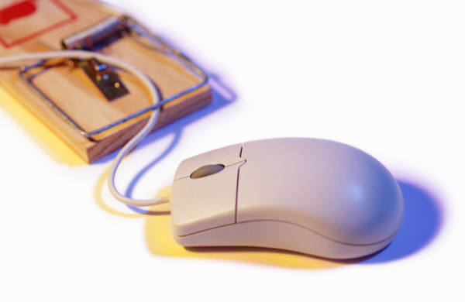
Shirts
Mouse in mouse trap
  Long sleeve
  Short sleeve
  Child’s shirt
Version 2.0
  Child’s shirt
  Baby shirt

Slide 3

Mugs
Mouse in mouse trap
Power Buttin
  Color change
To err is human, to really screw up you need a computer

Slide 4
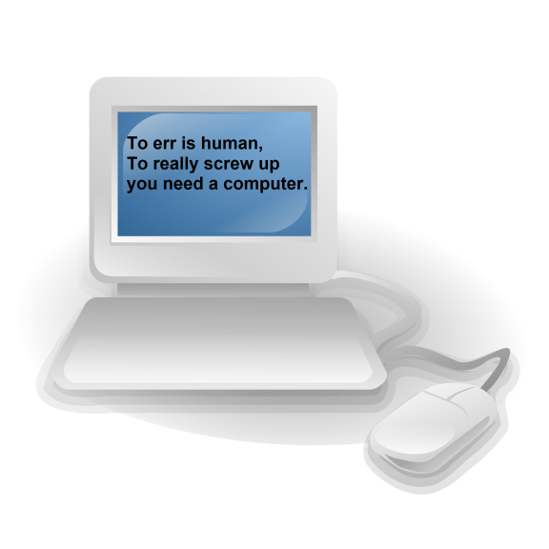
Mouse Pads
To err is human, to really screw up you need a computer
Power Button

