Slide 1
Reach for the Stars

Slide 2
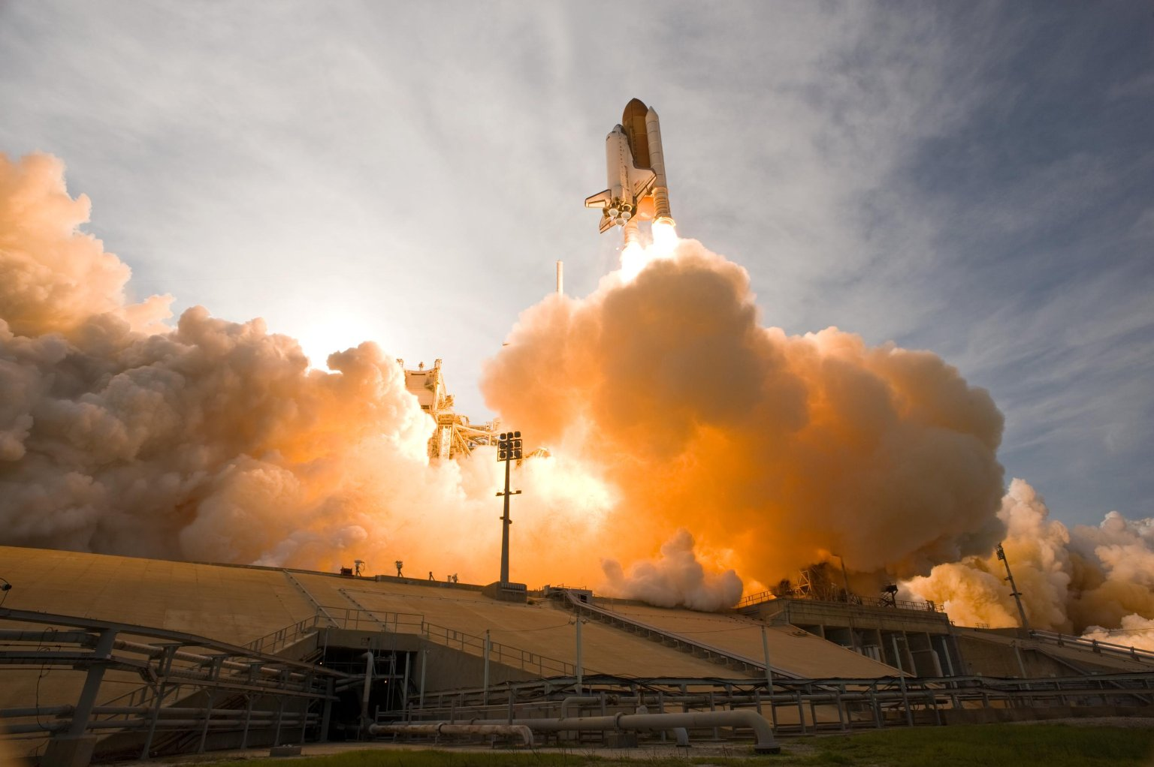
I built a shiny star ship

Slide 3
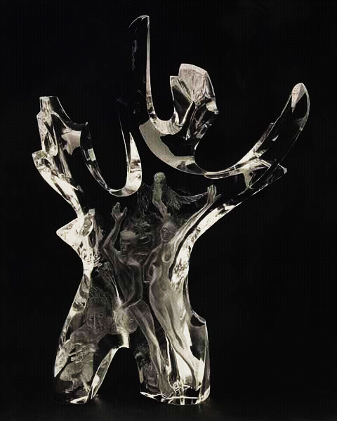
Made of silicon and glass

Slide 4
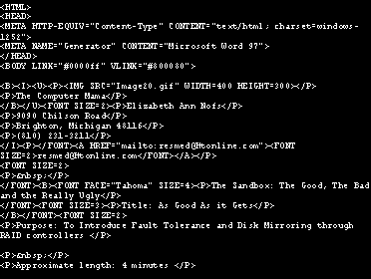
Little bits of code

Slide 5
And a dozen lights that flash

Slide 6
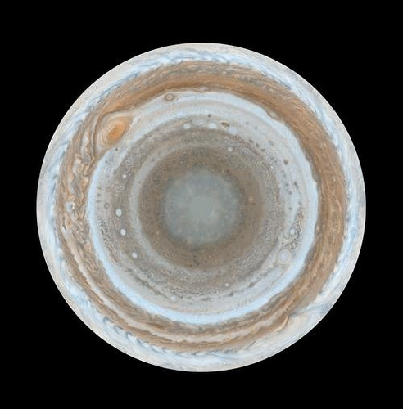
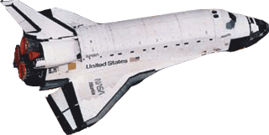
It’s me and my machine

Slide 7
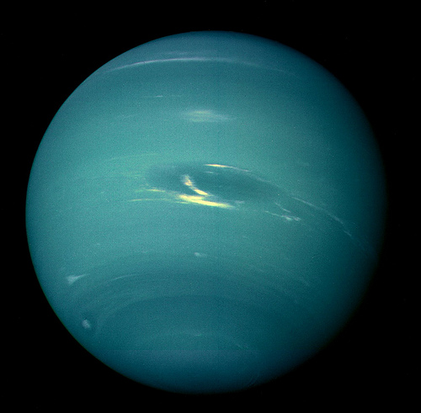
Eager to join the race

Slide 8
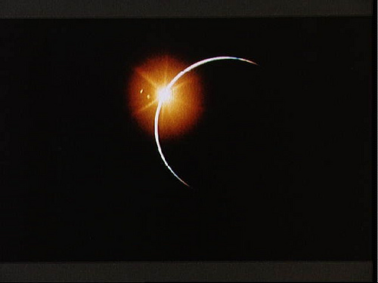
O, the things we can explore

Slide 9
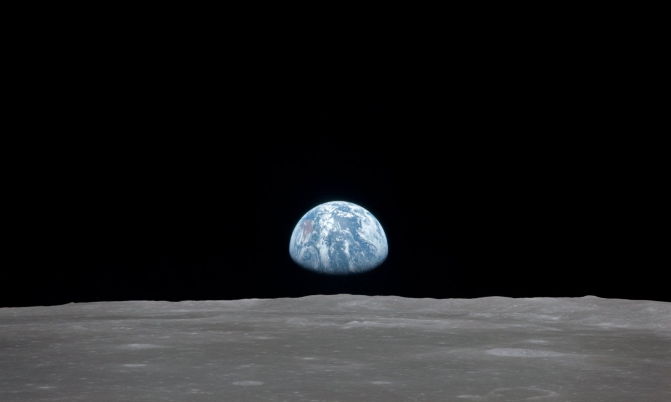
As we cruise through cyberspace!

