Slide 1
Sand hill Cranes

Slide 2
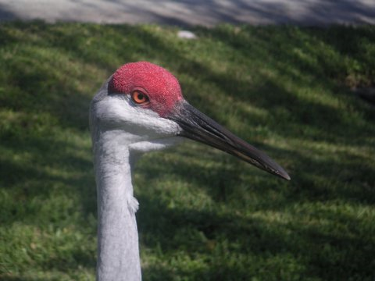
The Most Common of all the World’s Cranes

Slide 3
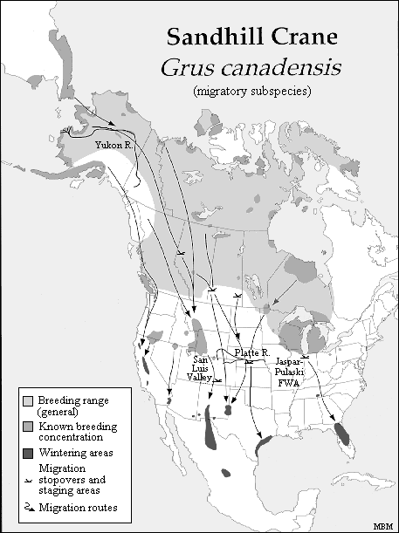
Found predominantly in North America

Slide 4
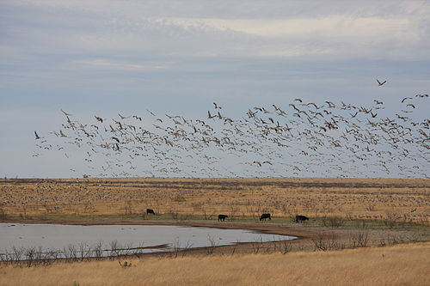
Live in freshwater wetlands

Slide 5
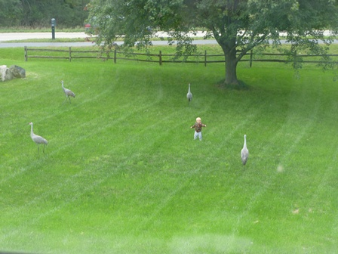
Feed on plants, grains, mice, snakes, insects and worms

