Slide 1
Show Time
Introducing the new desserts at Charlotte’s Website

Slide 2
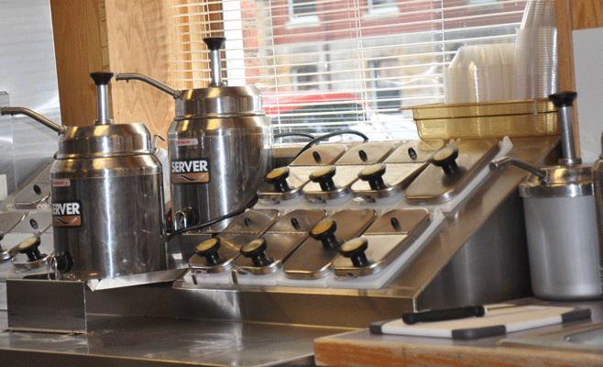
Put On Your Top Hat

Slide 3
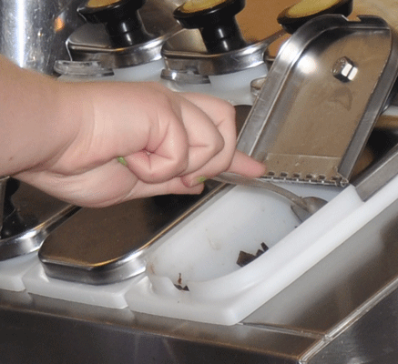
White Feathers and Tails
Frozen desserts
Fresh ingredients
Fun toppings

Slide 4
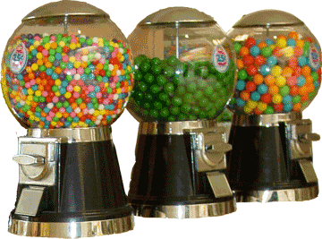
Paint Up Your Faces
Colorful products
Tasty flavors in small packages

Slide 5
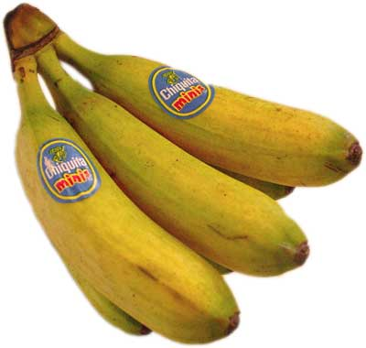
Your Reds and Your Pales

