Slide 1
Charlotte’s Website
New Fall Products

Slide 2
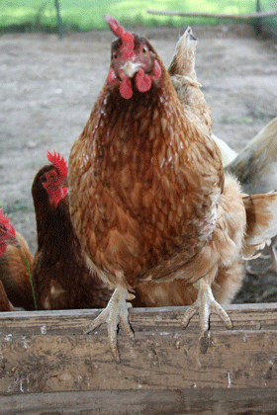
Charlotte’s Website

