Slide 1
Song of Solomon

Slide 2
For, Lo, the Winter is Past
Winter

Slide 3
The Rain is Over and Gone
Spring

Slide 4
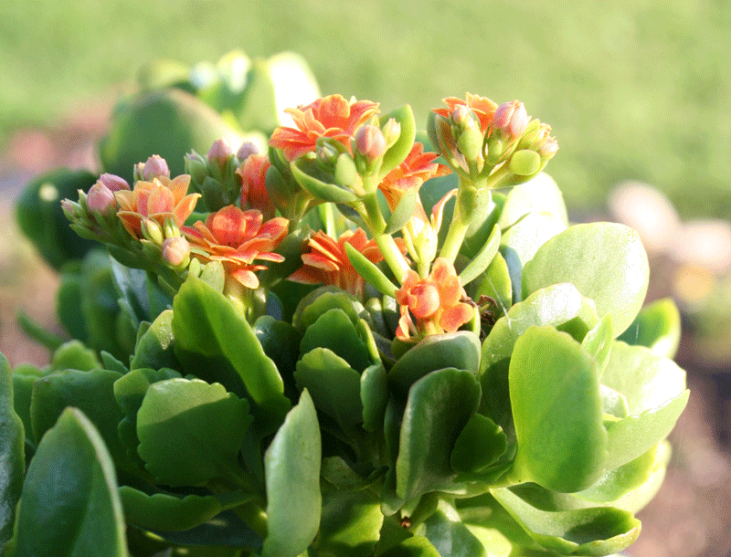
The Flowers Appear on the Earth
Flowers Appear

