Slide 1
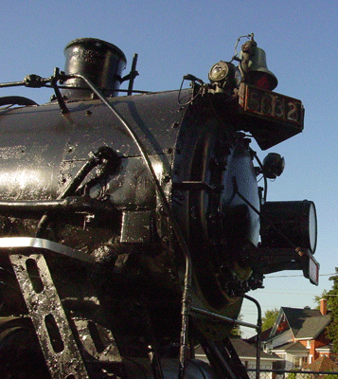
The Pere Marquette

Slide 2
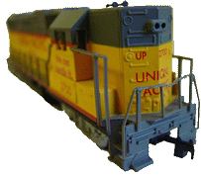
Engine, Engine No 9

Slide 3
Going Down Chicago Line

Slide 4
If the Train Should Jump the Track

Slide 5
Do You Want Your Money Back?

