Slide 1
Top Ten Reasons to Hire Me

Slide 2
10. Football

Slide 3
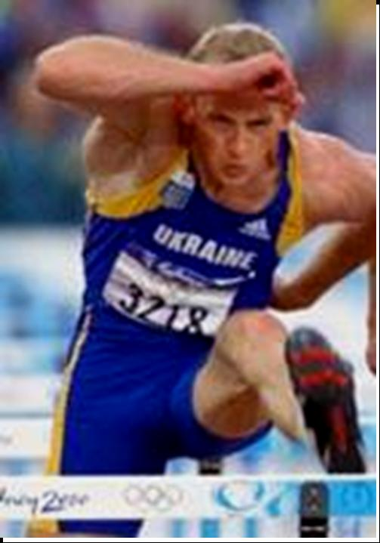
9. Track

Slide 4
8. Hockey

Slide 5
7. Baseball

Slide 6
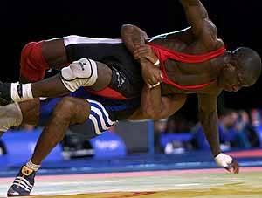
6. Wrestling

Slide 7
5. Swimming

Slide 8
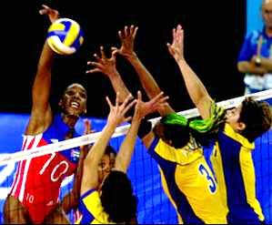
4. Volleyball

Slide 9
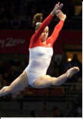
3. Gymnastics

Slide 10
2. Basketball
Sample 1
Sample 2
Sample 3

Slide 11
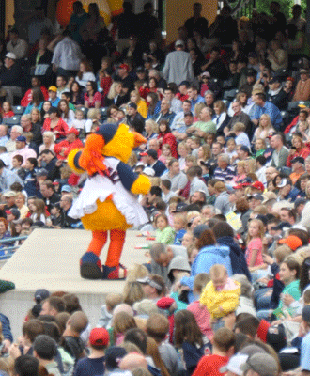
1. We complete the team!

